Slide 1
Building Python Programs
Chapter 3: Parameters and Graphics

Slide 2
parameters

Slide 3
Redundant figures
Consider the task of printing the following picture:
  .-'';'-.
  ,' <_,-.`.
  /) ,--,_>\_\
  |' ( \_ |
  |_ `-. / |
  \`-. ; _(`/
  `.( \/ ,'
  `-....-'
  ___ _
  /= =\/')
  /= = =\/
  ou ou
  ___ _
  /v v\/')
  /v v v\/
  ou ou

Slide 4
A redundant solution
This code is redundant.
Would variables help?
Would constants help?
What is a better solution?
def main():
world()
turtle_equal()
turtle_v()
def world():
print(" .-'';'-.")
print(" ,' <_,-.`.")
print(" /) ,--,_>\\_\\")
print(" |' ( \\_ |")
print(" |_ `-. / |")
print(" \`-. ; _(`/")
print(" `.( \/ ,'")
print(" `-....-'")
def turtle_equal():
print(" ___ _")
print(" /= =\\/')")
print(" /= = =\\/")
print(" ou ou")
def turtle_v():
print(" ___ _")
print(" /v v\\/')")
print(" /v v v\\/")
print(" ou ou")
main()
  turtle - A function to draw a turtle of any shell pattern.

Slide 5
Parameterization
parameter: A value passed to a function by its caller.
  Instead of turtle_equal, turtle_v, write turtle to draw any turtle.
    When declaring the function, we will state that it requires a parameter for the number of stars.
    When calling the function, we will specify how many stars to draw.
"="
  /= =\/')
  /= = =\/
  ou ou
main
turtle
"v"
turtle
  /v v\/')
  /v v v\/
  ou ou

Slide 6
Declaring a parameter
Stating that a function requires a parameter in order to run
  def <name> (<name>):
  <statement>(s)
Example:
  def say_password(code):
  print("The password is:", code)
  When say_password is called, the caller must specify the code to print.

Slide 7
Passing a parameter
Calling a function and specifying values for its parameters
  <name>(<expression>)
Example:
  say_password(42)
  say_password(12345)
  Output:
  The password is 42
  The password is 12345

Slide 8
Parameters and loops
A parameter can guide the number of repetitions of a loop.
  chant(3)
  def chant(times):
  for i in range(0, times):
  print("Just a salad...")
  Output:
  Just a salad...
  Just a salad...
  Just a salad...

Slide 9
How parameters are passed
When the function is called:
  The value is stored into the parameter variable.
  The function's code executes using that value.
  chant(3)
  chant(7)
  def chant(times):
  for i in range(0, times):
  print("Just a salad...")
3
7

Slide 10
Common errors
If a function accepts a parameter, it is illegal to call it without passing any value for that parameter.
  chant() # ERROR: parameter value required
The value passed to a function must be of a type that will work.
  chant(3.7) # ERROR: must be of type int if it
  # is used as a range bound
Exercise: Change the counts program to use a parameterized function for drawing lines of numbers.

Slide 11
Multiple parameters
A function can accept multiple parameters. (separate by , )
  When calling it, you must pass values for each parameter.
Declaration:
  def <name>(<name>, ..., <name>):
  <statement>(s)
Call:
  <name>(<exp>, <exp>, ..., <exp>)

Slide 12
Multiple parameters example
def main():
print_number(4, 9)
print_number(17, 6)
print_number(8, 0)
print_number(0, 8)
def print_number(number, count):
for i in range(0, count):
print(number, end="")
print()
Output:
444444444
171717171717
00000000

Slide 13
A "Parameter Mystery" problem
  def main():
  x = 9
  y = 2
  z = 5
  mystery(z, y, x)
  mystery(y, x, z)
  def mystery(x, z, y):
  print(z, "and", (y - x))
Notes:
Output:
2 and 4
9 and 3

Slide 14
Value semantics
value semantics: When numbers and strings are passed as parameters, their values are copied.
  Modifying the parameter will not affect the variable passed in.
  def strange(x):
  x = x + 1
  print("1. x = ", x)
  def main():
  x = 23
  strange(x)
  print("2. x = ", x)
  ...
Output:
1. x = 24
2. x = 23

Slide 15
returns

Slide 16
Python's Math class
Method name | Description
math.ceil(value) | rounds up
math.floor(value) | rounds down
math.log(value, base) | logarithm
math.sqrt(value) | square root
math.sinh(value) math.cosh(value) math.tanh(value) | sine/cosine/tangent of an angle in radians
math.degrees(value) math.radians(value) | convert degrees to radians and back
Constant | Description
e | 2.7182818...
pi | 3.1415926...
import math necessary to use the above functions
Other math functions:
Function name | Description
abs(value) | absolute value
min(value1, value2) | smaller of two values
max(value1, value2) | larger of two values
round(value) | nearest whole number

Slide 17
No output?
Simply calling these functions produces no visible result.
  math.sqrt(81) # no output
Math function calls use a Python feature called return values that cause them to be treated as expressions.
The program runs the function, computes the answer, and then "replaces" the call with its computed result value.
  math.sqrt(81) # no output
  9.0 # no output
To see the result, we must print it or store it in a variable.
  result = math.sqrt(81)
  print(result) # 9.0

Slide 18
Return
return: To send out a value as the result of a function.
  Return values send information out from a function to its caller.
    A call to the function can be used as part of an expression.
  (Compare to parameters which send values into a function)
-42
abs(-42)
42
main
2.71
3
math.ceil(2.71)

Slide 19
Math questions
Evaluate the following expressions:
  abs(-1.23)
  math.sqrt(121.0) - math.sqrt(256.0)
  round(pi) + round(e)
  math.ceil(6.022) + math.floor(15.9994)
  abs(min(-3, -5))
math.max and math.min can be used to bound numbers.
  Consider a variable named age.
  What statement would replace negative ages with 0?
  What statement would cap the maximum age to 40?

Slide 20
Why return and not print?
It might seem more useful for the math functions to print their results rather than returning them. Why don't they?
Answer: Returning is more flexible than printing.
  We can compute several things before printing:
  sqrt1 = math.sqrt(100)
  sqrt2 = math.sqrt(81)
  print("Powers are", sqrt1, "and", sqrt2)
  We can combine the results of many computations:
  k = 13 * math.sqrt(49) + 5 - math.ceil(17.8)

Slide 21
Quirks of real numbers
Some float values print poorly (too many digits).
  result = 1.0 / 3.0
  print(result) # 0.3333333333333
The computer represents floats in an imprecise way.
  print(0.1 + 0.2)
  Instead of 0.3, the output is 0.30000000000000004

Slide 22
Type casting
type cast: A conversion from one type to another.
  To truncate a double from a real number to an integer
Syntax:
  type (expression)
  Examples:
  result = 19 / 5 # 3.8
  result2 = int(result) # 3
  x = int(sqrt(121)) # 1000

Slide 23
Returning a value
  def name(parameters):
  statements
  ...
  return expression
When Python reaches a return statement:
  it evaluates the expression
  it substitutes the return value in place of the call
  it goes back to the caller and continues after the method call

Slide 24
Return examples
# Converts degrees Fahrenheit to Celsius.
def f_to_c(degrees_f):
degrees_c = 5.0 / 9.0 * (degrees_f - 32)
return degrees_c
# Computes triangle hypotenuse length given its side lengths.
def hypotenuse(a, b):
c = math.sqrt(a * a + b * b)
return c
You can shorten the examples by returning an expression:
  def f_to_c(degrees_f):
  return 5.0 / 9.0 * (degrees_f - 32)

Slide 25
Common error: Not storing
Many students incorrectly think that a return statement sends a variable's name back to the calling method.
  def main():
  slope(0, 0, 6, 3)
  print("The slope is", result); # ERROR: cannot find symbol: result
  def slope(x1, x2, y1, y2):
  dy = y2 - y1
  dx = x2 - x1
  result = dy / dx
  return result

Slide 26
Fixing the common error
Returning sends the variable's value back. Store the returned value into a variable or use it in an expression.
  def main():
  s = slope(0, 0, 6, 3)
  print("The slope is", s)
  def slope(x1, x2, y1, y2):
  dy = y2 - y1
  dx = x2 - x1
  result = dy / dx
  return result

Slide 27
Exercise
In physics, the displacement of a moving body represents its change in position over time while accelerating.
  Given initial velocity v₀ in m/s, acceleration a in m/s², and elapsed time t in s, the displacement of the body is:
  Displacement = v₀ t + ½ a t ²
Write a method displacement that accepts v₀, a, and t and computes and returns the change in position.
  example: displacement(3.0, 4.0, 5.0) returns 65.0

Slide 28
Exercise solution
def displacement(v0, a, t):
d = v0 * t + 0.5 * a * (t ** 2)
return d

Slide 29
Exercise
If you drop two balls, which will hit the ground first?
  Ball 1: height of 600m, initial velocity = 25 m/sec downward
  Ball 2: height of 500m, initial velocity = 15 m/sec downward
Write a program that determines how long each ball takes to hit the ground (and draws each ball falling).
Total time is based on the force of gravity on each ball.
  Acceleration due to gravity ≅ 9.81 m/s², downward
  Displacement = v₀ t + ½ a t ²

Slide 30
Ball solution
# Simulates the dropping of two balls from various heights.
def main():
panel = DrawingPanel(600, 600)
ball1x = 100
ball1y = 0
v01 = 25
ball2x = 200
ball2y = 100
v02 = 15
# draw the balls at each time increment
for time in range(60):
disp1 = displacement(v01, time/10, 9.81)
panel.fill_oval(ball1x, ball1y + disp1, ball1x + 10, ball1y + 10 + disp1)
disp2 = displacement(v02, time/10, 9.81)
panel.fill_oval(ball2x, ball2y + disp2, ball2x + 10, ball2y + 10 + disp2)
panel.sleep(50) # pause for 50 ms
panel.fill_rect(0, 0, 600, 600, "white")
...

Slide 31
Interactive Programs

Slide 32
Interactive programs
interactive program: Reads input from the console.
While the program runs, it asks the user to type input.
The input typed by the user is stored in variables in the code.
Can be tricky; users are unpredictable and misbehave.
But interactive programs have more interesting behavior.

Slide 33
input
input: An function that can read input from the user.
Using an input object to read console input:
  name = input(prompt)
  Example:
  name = input("type your name: ")
    The variable name will store the value the user typed in

Slide 34
input example
  def main():
  age = input("How old are you? ")
  years = 65 - age
  print(years, " years until retirement!")
Console (user input underlined):
  How old are you?
age | 29
29
Traceback (most recent call last):
File "<pyshell#13>", line 1, in <module>
print(65 - age)
TypeError: unsupported operand type(s) for -: 'int' and 'str'
Notes:
It's also useful to write a program that prompts for multiple values, both on the same line or each on its own line.

Slide 35
input example
  def main():
  age = int(input("How old are you? "))
  years = 65 - age
  print(years, "years until retirement!")
Console (user input underlined):
  How old are you?
  36 years until retirement!
age | 29
years | 36
29
Notes:
It's also useful to write a program that prompts for multiple values, both on the same line or each on its own line.

Slide 36
Graphics

Slide 37
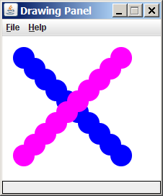
Graphical objects
We will draw graphics in Python using a new kind of object:
DrawingPanel: A window on the screen.
  Not part of Python; provided by the instructor. See class web site.

Slide 38
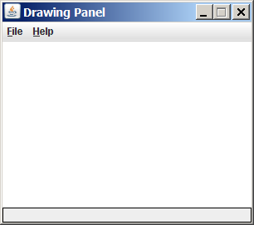
DrawingPanel
To create a window:
  <name> = DrawingPanel(<width>, <height>)
  <name> = DrawingPanel(<width>, <height>, background="color")
  Example:
  panel = DrawingPanel(300, 200)
The window has nothing on it.
  We can draw shapes and
  lines on it.
If passed the optional third parameter
it will have a background color

Slide 39
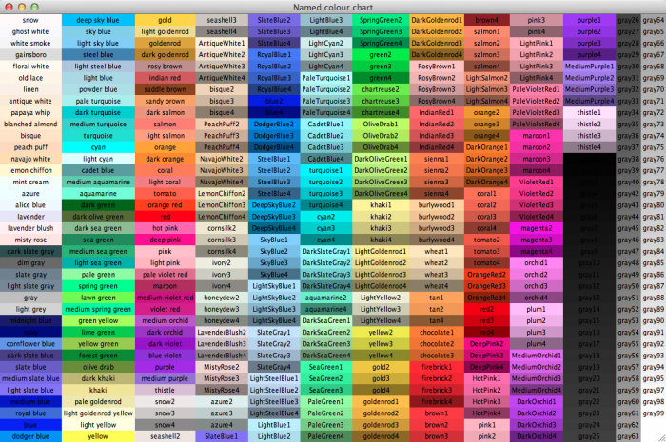
Named colors
Chart credit Smith.edu

Slide 40
Custom colors
You can construct custom colors using hex.
  # followed by six numbers 0 – 9 and letters A – F
    A is 10, B is 11 and so on
    #000000 is black
    #FFFFFF is white
    Colors get darker as the number gets lower
    The first two digits are the amount of red, the next two green, the last two blue
  panel = DrawingPanel(80, 50, background="#3367D3")

Slide 41
Drawing shapes
Function name | Description
p.draw_line(x1, y1, x2, y2) | line between points (x1, y1), (x2, y2)
p.draw_oval(x, y, width, height) | outline largest oval that fits in a box of size width * height with top-left at (x, y)
p.draw_rect(x, y, width, height) | outline of rectangle of size width * height with top-left at (x, y)
p.draw_string("text", x, y) | text with upper-left at (x, y)
p.fill_oval(x, y, width, height) | fill largest oval that fits in a box of size width * height with top-left at (x,y)
p.fill_rect(x, y, width, height) | fill rectangle of size width * height with top-left at (x, y)
p.set_color("color") | set the default color to "color"
You can pass an additional "color" to any shape as a last parameter
  p.draw_rect(50, 100, 60, 60, "red")

Slide 42
Coordinate system
Each (x, y) position is a pixel ("picture element").
(0, 0) is at the window's top-left corner.
  x increases rightward and the y increases downward.
The rectangle from (0, 0) to (200, 100) looks like this:
  (0, 0) x+
  (200, 100)
  y+

Slide 43
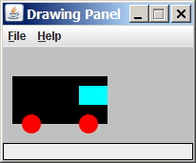
Superimposing shapes
When two shapes occupy the same pixels, the last one drawn is seen.
from DrawingPanel import *
def main():
p = DrawingPanel(200, 100, background="light gray")
p.fill_rect(10, 30, 100, 50, "black")
p.fill_oval(20, 70, 20, 20, "red")
p.fill_oval(80, 70, 20, 20, "red")
p.fill_rect(80, 40, 30, 20, "cyan")

Slide 44
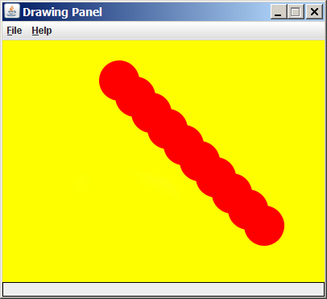
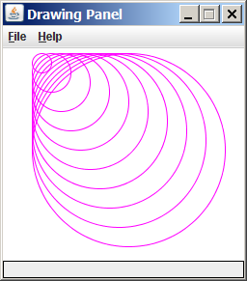
Drawing with loops
The x1, y1, w, h expression can contain the loop counter, i.
  panel = DrawingPanel(400, 300, background="yellow")
  for i in range(1, 11):
  panel.fill_oval (100 + 20 * i, 5 + 20 * i,
  50, 50, "red")
  panel = DrawingPanel(250, 220)
  for i in range(1, 11):
  panel.draw_oval (30, 5, 20 * i, 20 * i, "magenta")

Slide 45
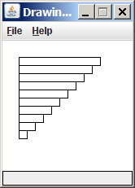
Loops that begin at 0
Beginning a loop at 0 and using < can make coordinates easier to compute.
Example:
  Draw ten stacked rectangles starting at (20, 20), height 10, width starting at 100 and decreasing by 10 each time:
  panel = DrawingPanel(160, 160)
  for i in range(10):
  panel.draw_rect(20, 20 + 10 * i, 100 – 10 * i, 10)

Slide 46
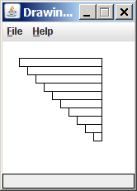
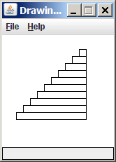
Exercise: drawing with loops
  panel = DrawingPanel(160, 160)
  for i in range(0, 10):
  panel.draw_rectangle (20, 20 + 10 * i,
  100 – 10 * i, 10)
Write variations of the above
program that draw the figures
at right as output.

Slide 47
Drawing w/ loops answers
Solution #1:
  panel = DrawingPanel(160, 160)
  for i in range(0, 10):
  panel.draw_rect(20 + 10 * i, 20 + 10 * i,
  100 - 10 * i, 10)
Solution #2:
  panel = DrawingPanel(160, 160)
  for i in range(0, 10):
  panel.draw_rect(110 - 10 * i, 20 + 10 * i,
  10 + 10 * i, 10)

Slide 48
Drawing with functions
To draw in multiple functions, you must pass DrawingPanel.
def main():
panel = DrawingPanel(200, 100, background="light gray")
draw_car(panel)
def draw_car(p):
p.fill_rect(10, 30, 100, 50, "black")
p.fill_oval(20, 70, 20, 20, "red")
p.fill_oval(80, 70, 20, 20, "red")
p.fill_rect(80, 40, 30, 20, "cyan")

Slide 49
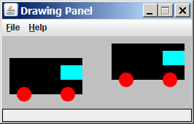
Parameterized figures
Modify the car-drawing function so that it can draw many cars, such as in the following image.
  Top-left corners: (10, 30), (150, 10)
  Hint: We must modify our draw_car function to accept x/y coordinates as parameters.

Slide 50
Parameterized answer
def main():
panel = DrawingPanel(260, 100, background="light gray")
draw_car(panel, 10, 30)
draw_car(panel, 150, 10)
def draw_car(p, x, y):
p.fill_rect(x, y, 100, 50, "black")
p.fill_oval(x + 10, y + 40, 20, 20, "red")
p.fill_oval(x + 70, y + 40, 20, 20, "red")
p.fill_rect(x + 70, y + 10, 30, 20, "cyan")

Slide 51
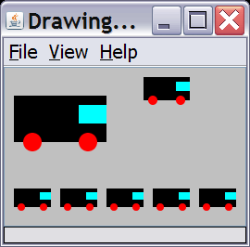
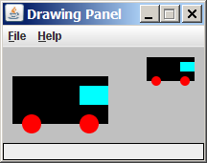
Drawing parameter question
Modify draw_car to allow the car to be drawn at any size.
  Existing car: size 100. Second car: (150, 10), size 50.
Once you have this working, use a for loop with your function to draw a line of cars, like the picture at right.
  Start at (10, 130), each size 40, separated by 50px.

Slide 52
Drawing parameter answer
def main():
panel = DrawingPanel(260, 100, background="light gray")
draw_car(panel, 10, 30, 100)
draw_car(panel, 150, 10, 50)
for i in range(0, 5):
draw_car(panel, 10 + i * 50, 130, 40);
def draw_car(p, x, y, size):
p.fill_rect(x, y, size, size / 2, "black")
p.fill_oval(x + size / 10, y + size / 5 * 2, size / 5, size / 5, "red")
p.fill_oval(x + size / 10 * 7, y + size / 5 * 2, size / 5, size / 5, "red")
p.fill_rect(x + size / 10 * 7, y + size / 10, size / 10 * 3, size / 5, "cyan")

Slide 53
Animation with sleep
DrawingPanel's sleep function pauses your program for a given number of milliseconds.
You can use sleep to create simple animations.
  panel = DrawingPanel(250, 200)
  for i in range(1, NUM_CIRCLES + 1):
  panel.draw_oval(15 * i, 15 * i, 30, 30)
  panel.sleep(500)
  Try adding sleep commands to loops in past exercises in this chapter and watch the panel draw itself piece by piece.

Slide 54
Random

Slide 55
Pseudo-Randomness
Computers generate numbers in a predictable way using a mathematical formula
Parameters may include current time, mouse position
  In practice, hard to predict or replicate
True randomness uses natural processes
  Atmospheric noise (http://www.random.org/)
  Lava lamps (patent #5732138)
  Radioactive decay

Slide 56
Random
Method name | Description
random.random() | returns a random float in the range [0, 1) in other words, 0 inclusive to 1 exclusive
random.randint(min, max) | returns a random integer in the range [min, max] in other words, min to max inclusive
random generates pseudo-random numbers.
  random can be accessed by including the following statement:
  import random
  Example:
  import random
  random_number = random.randint(1, 10) # 1-9

Slide 57
Generating random numbers
To get a number in arbitrary range [min, max] inclusive:
  random.randint(min, max)
    Where size of range is (max – min + 1)
  Example: A random integer between 4 and 10 inclusive:
  n = random.randint(4, 10)

